Slide 1
Supervised Machine Learning to Identify Cells (Theory)
Ben Kuebrich

Slide 2
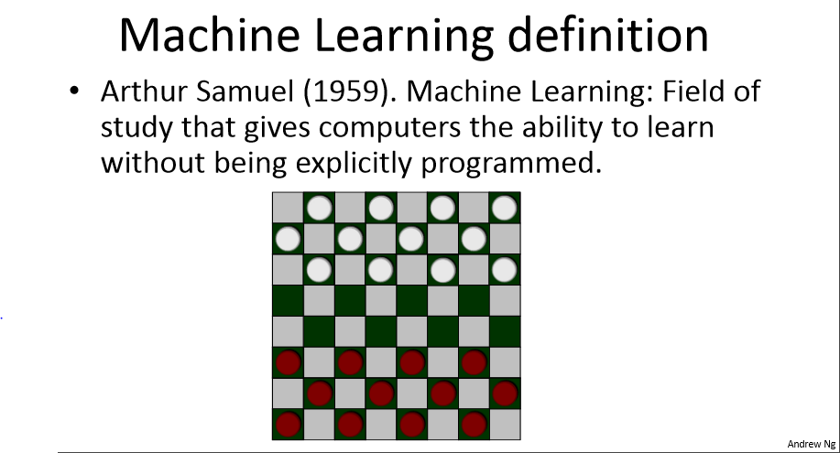
Andrew Ng

Slide 3
Two main categories of machine learning
Machine learning can be broadly divided into two categories:
1. Supervised
Computer is given Inputs and Desired Outputs
Computer learns how to “Map” Inputs→Outputs
2. Unsupervised
Computer is only given Inputs
Computer learns patterns/features within Inputs

Slide 4
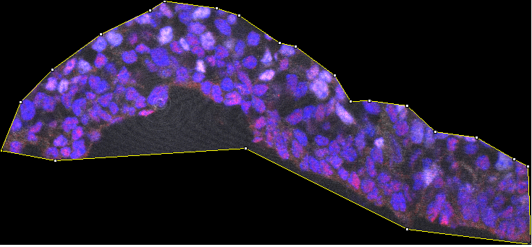
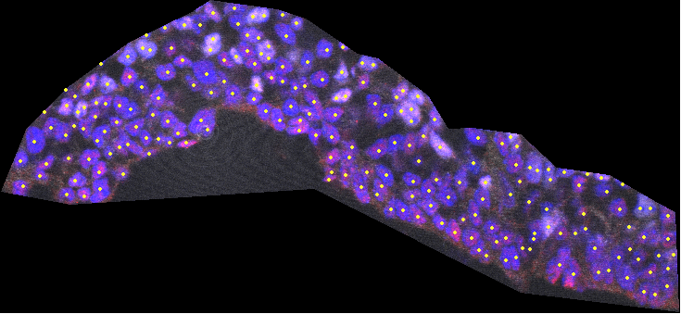
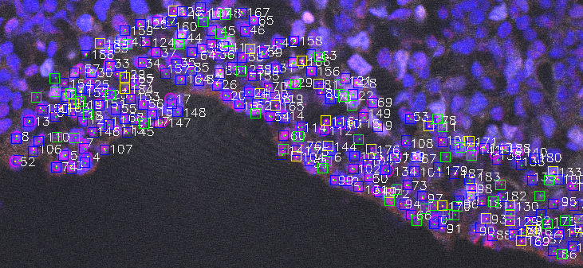
Supervised Approach
Computer is given Inputs (IHC images):
and Desired Outputs (Coordinates of cells within the images):
and the computer learns how to “Map” Inputs→Outputs (Learns which features of the IHC images should be labeled as cells):

Slide 5
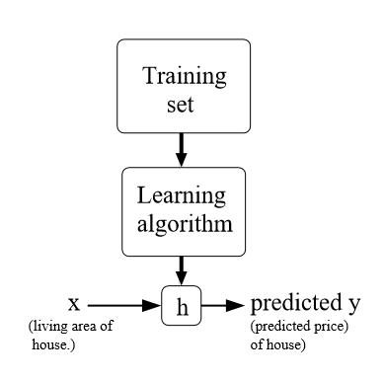
Once the Computer Learns, algorithm can be applied to new data
(Hand-Labeled
Training Images)
(Machine-labeled
Test Images)
(Un-labeled
Test Images)
(Un-labeled
Test Images)
Modified from Andrew Ng

Slide 6
But how does the Computer “Learn”
???
First, let’s discuss how the computer can analyze images, then lets discuss how it can “learn” to analyze images in a more effective way.

Slide 7
Image analysis
2-step approach:
1. Modify features of the image, using filters
e.g. Adjust contrast, blur, watershed, etc.
2. Identify cells in this modified image:
Blob detector

Slide 8
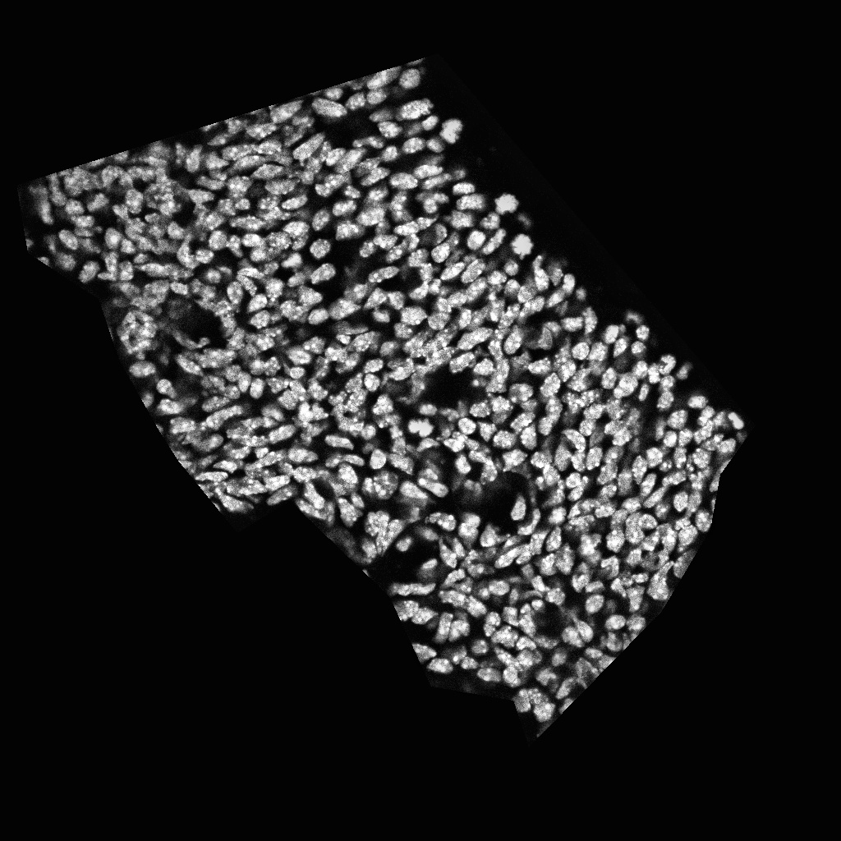
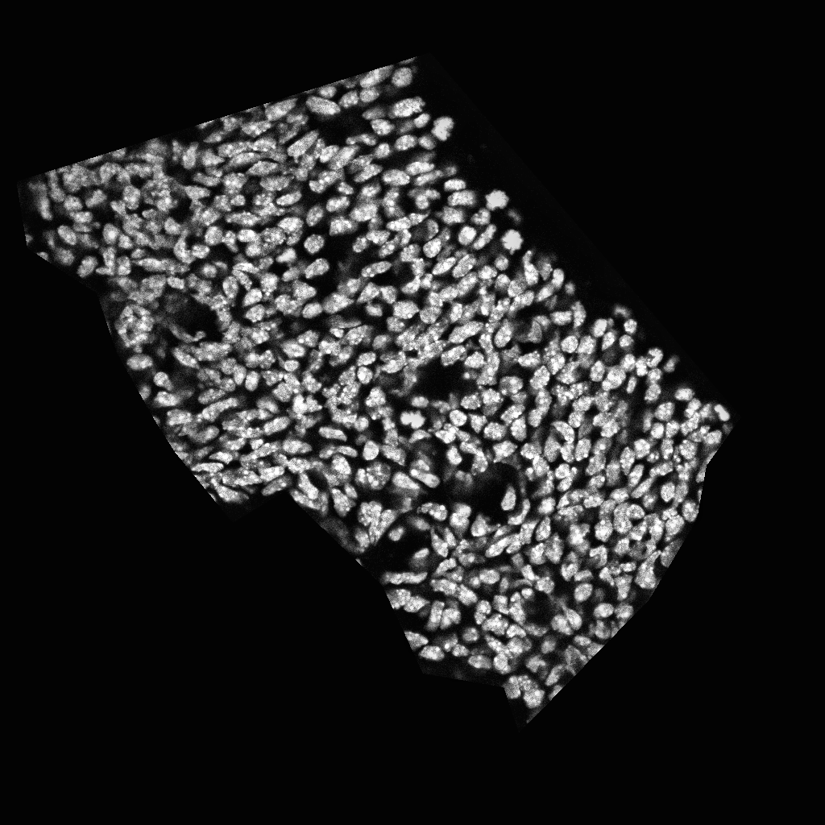
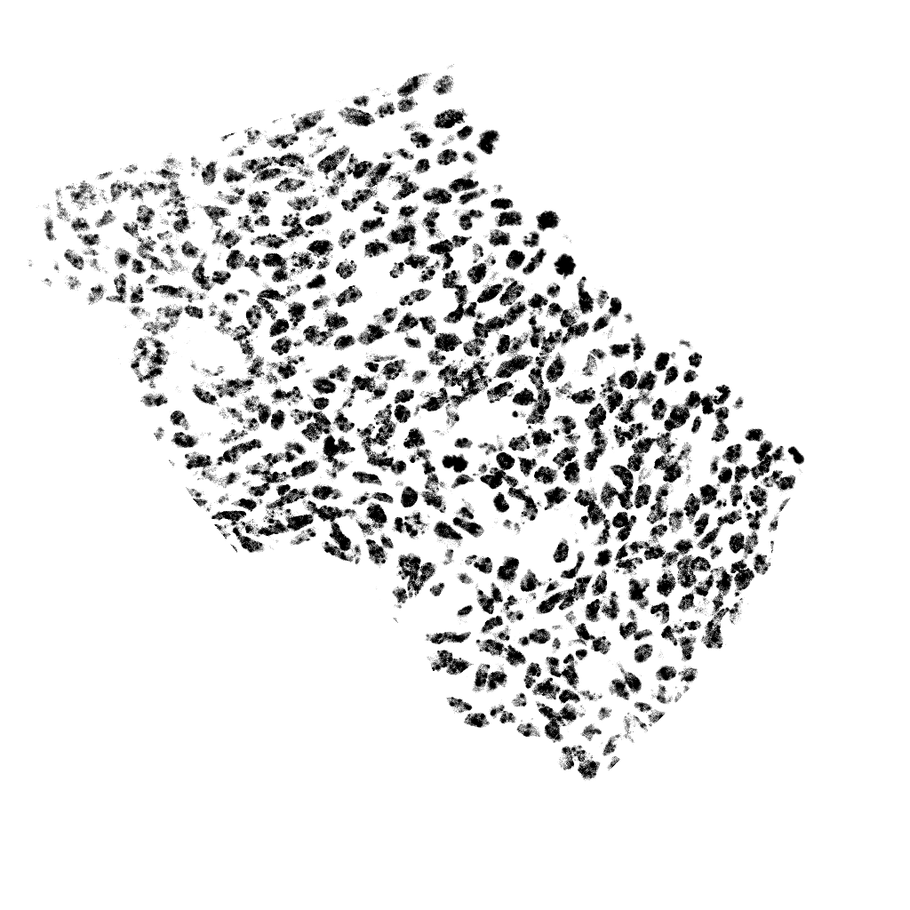
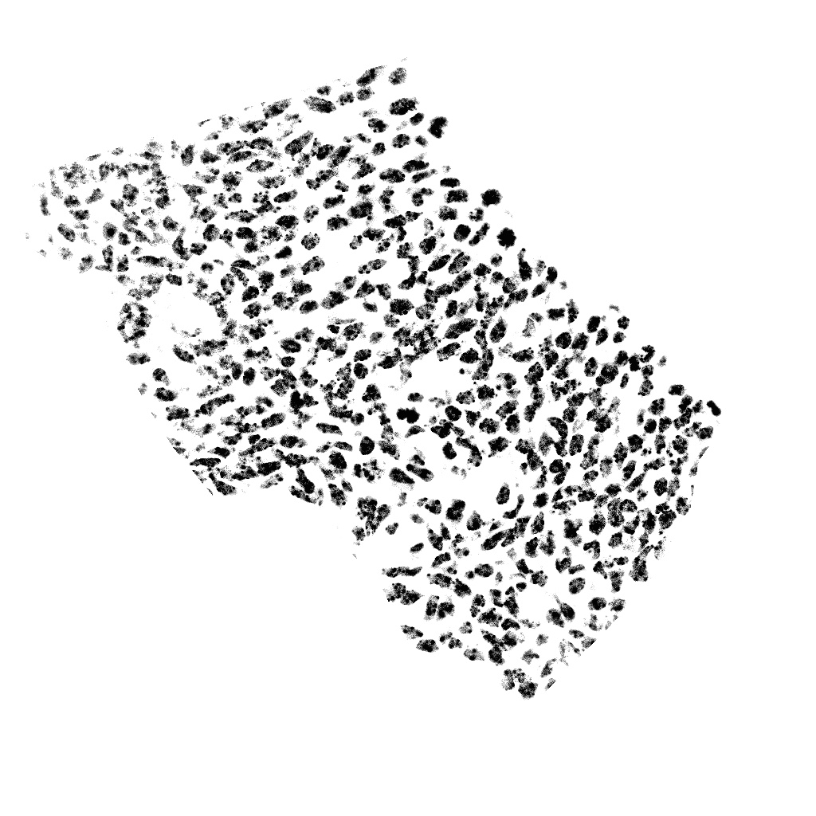

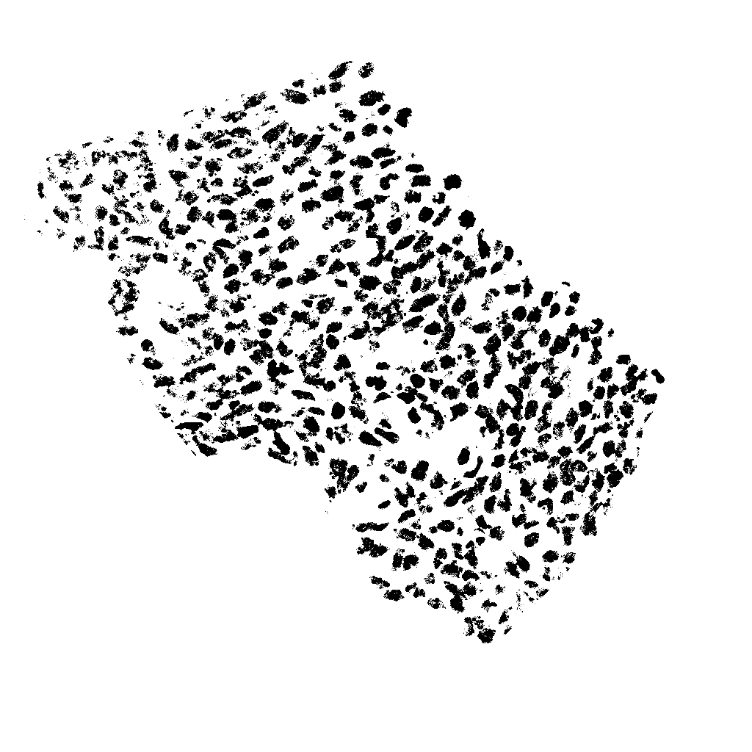
Example of filters applied after it has been trained

Slide 9
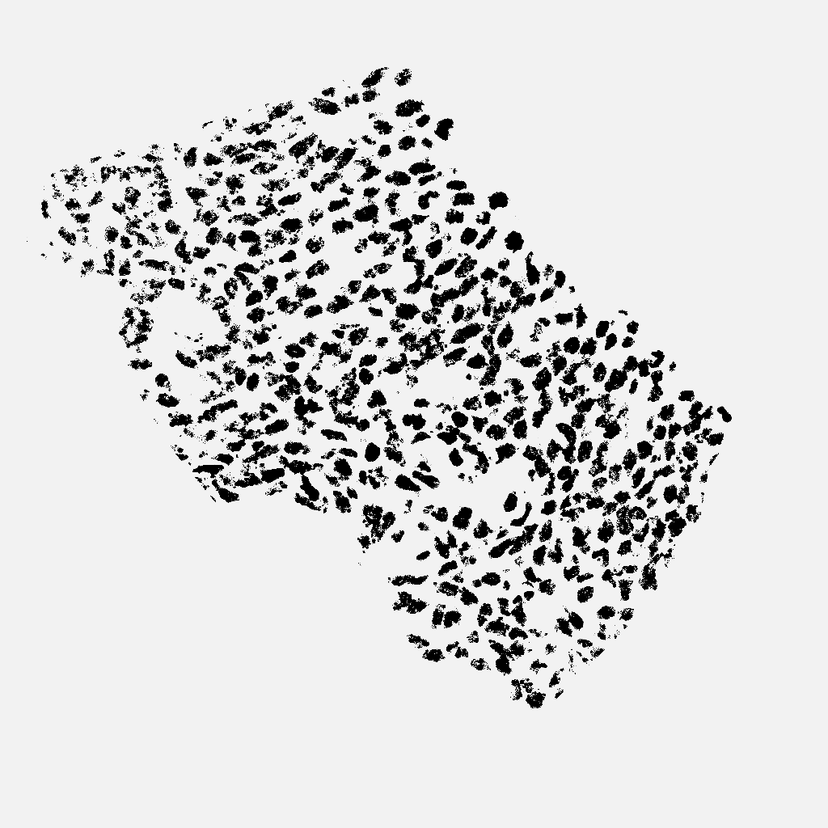
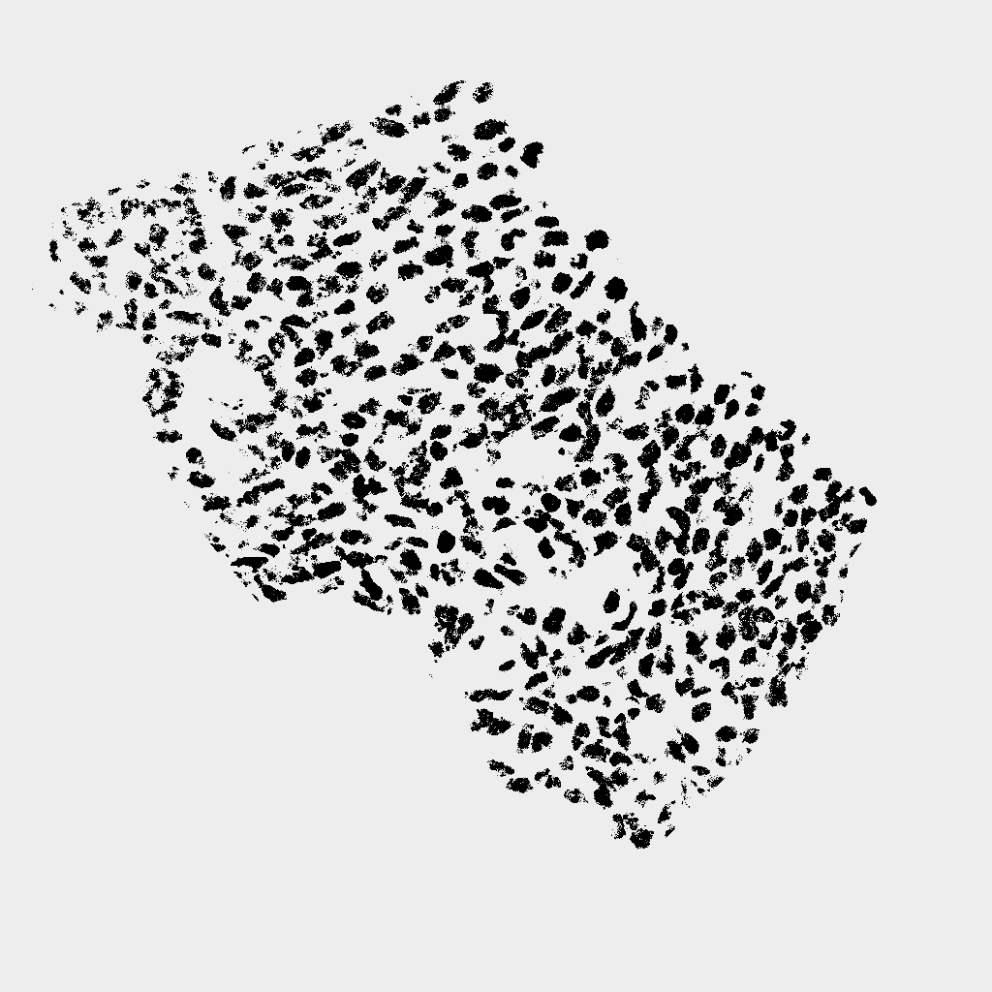

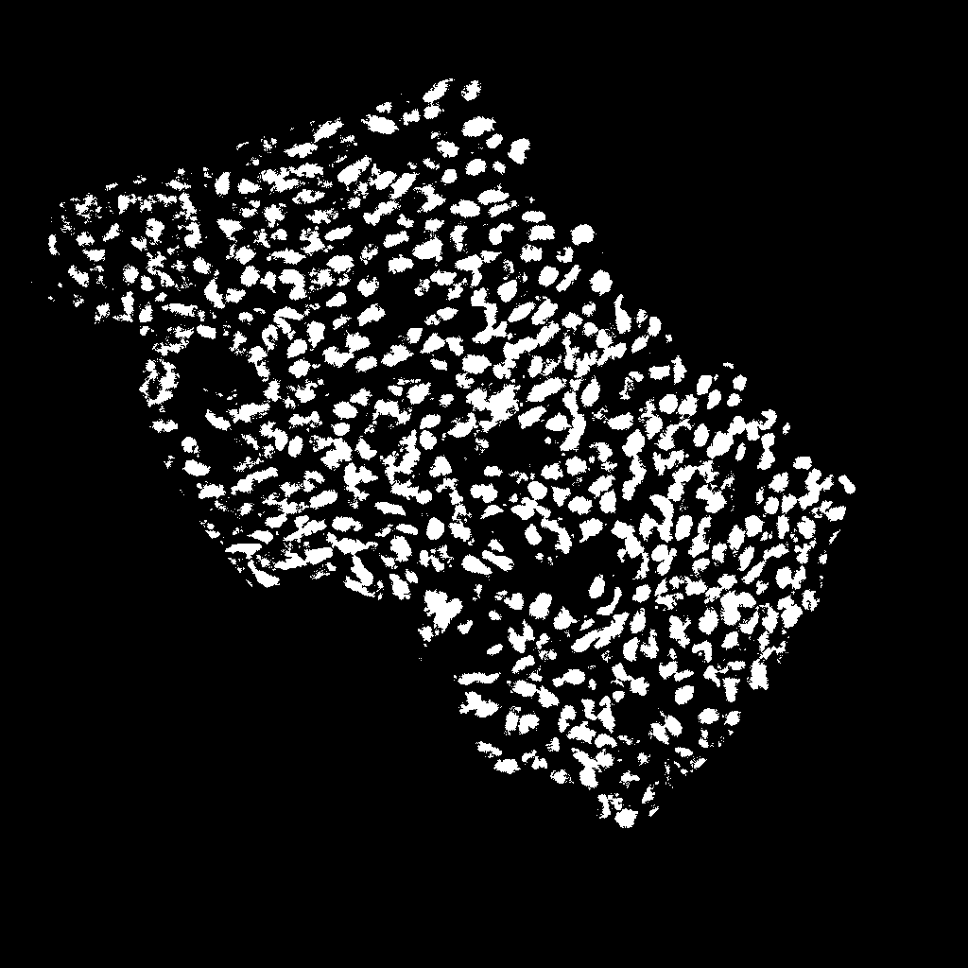
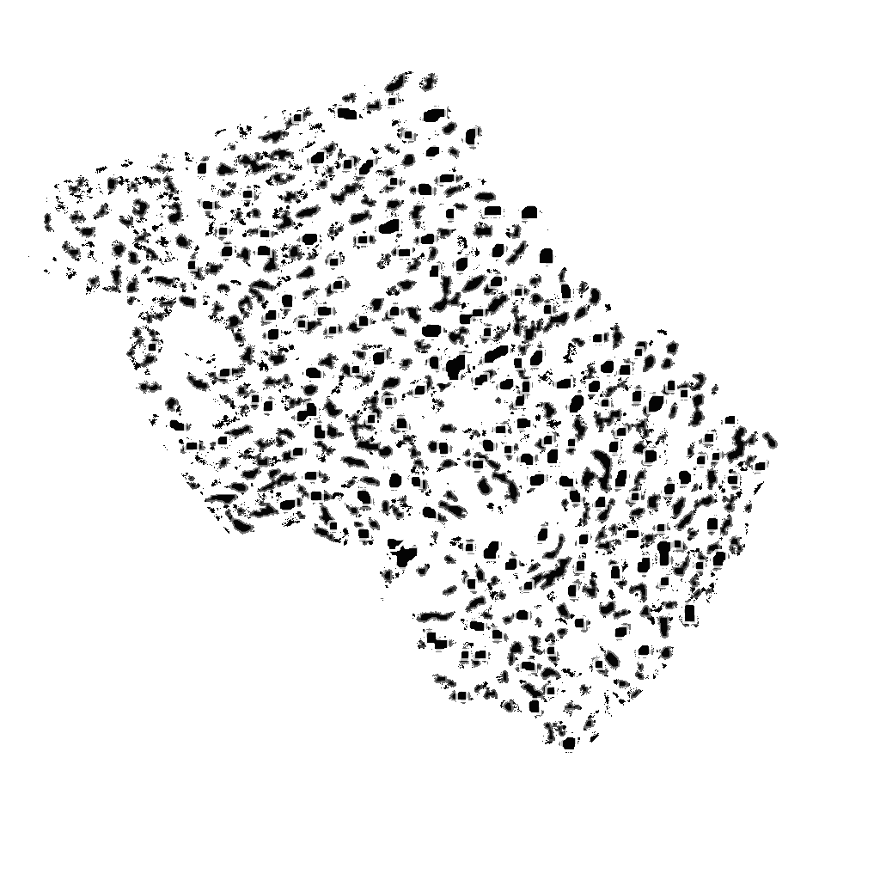


Slide 10
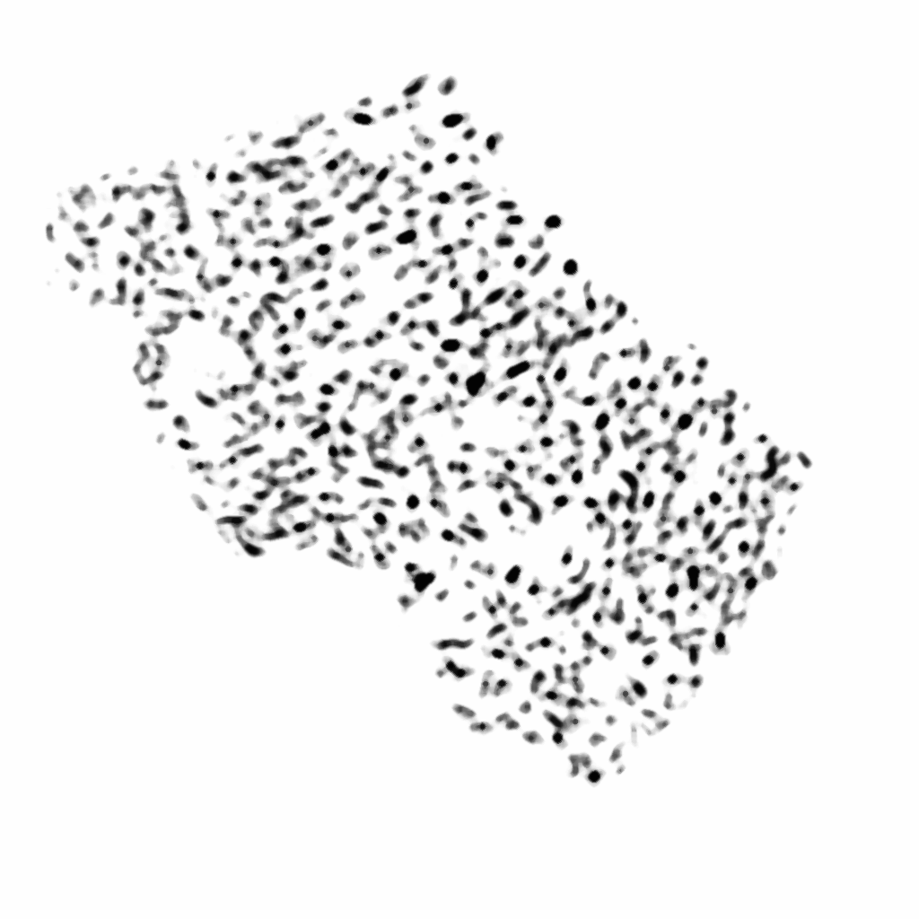
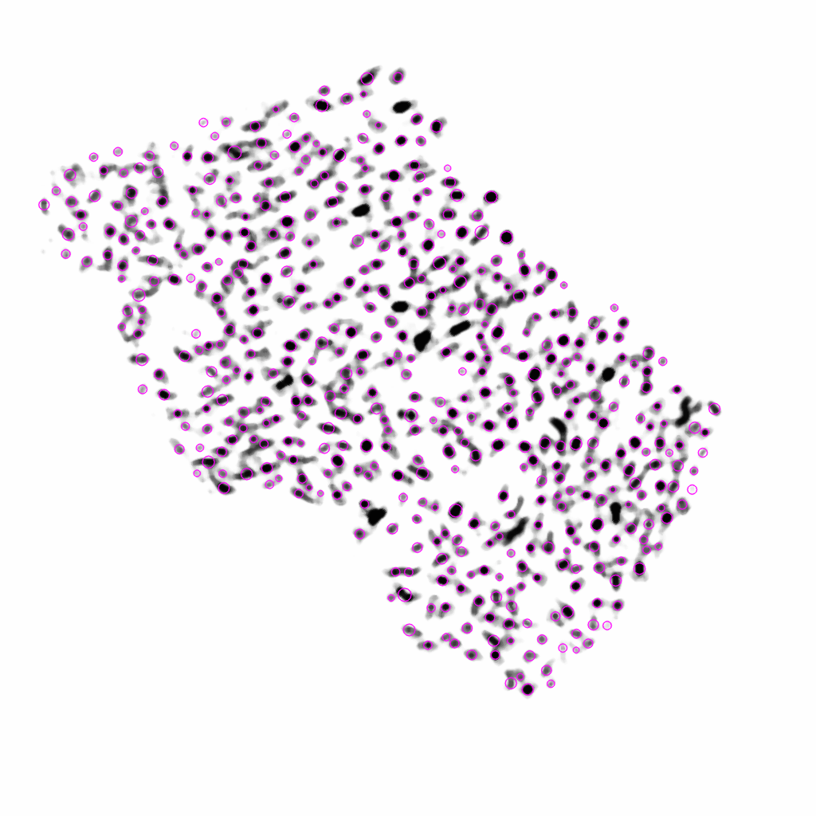
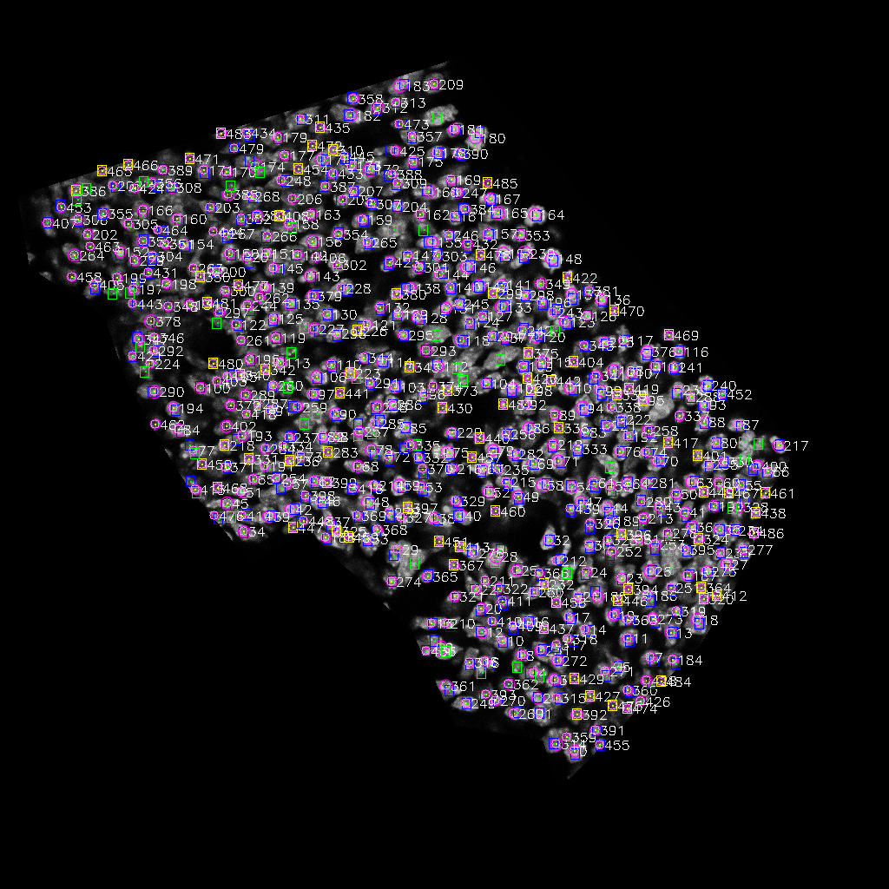

Slide 11
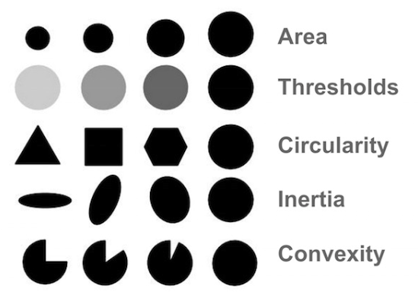
How did that last step happen
Blob Detector - A “Blob” is a group of connected pixels in an image that share some common property ( E.g grayscale value)
Can filter blobs by size, shape, intensity, etc.

Slide 12
How does learning take place?
What is the optimal way to filter the image, and use the best settings on the blob counter, so it counts each cell one time and does not count any artifacts?
Filters themselves have to be added by hand, but then the computer can decide which filters with which settings, and which blob detection parameters are the most effective

Slide 13
How does learning take place?
Image each one of the filter/blob-detector settings as a different dimension
In this case I’m exploring 42 features, so a 42-dimensional space. But it’s fine to image it as a 2-D space.
If we assume each feature has 10 settings, these features can be combined in 10⁴² ways.
It would take way too long to try to try every location in that space.
So instead can we explore that space in a systematic manner?

Slide 14
Gradient Descent
You can imagine the parameters as the X and Y coordinates, and the Z-coordinate as
Our supervised feedback, a measure of how well the computer is mapping inputs to outputs
With a particular set of parameters.
How do we calculate that Z? Can choose, but for our case we will want to factor in how many cells are correctly identified and incorrectly identified.
We then make a “cost function” that measures this: For example Z = FPs – TPs (low is good)

Slide 15
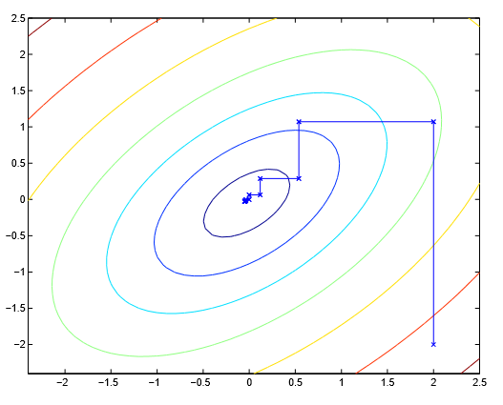
Many different approaches possible
Blue is best estimate
Red is worst
Andrew Ng

Slide 16
Descent strategy I used
Step in every dimension, does it improve the cost function compared to last round? If so, remember that movement (and also note if it is the best estimate so far)
After moving in every direction, try moving in all of the directions where you saw improvements so far.
If this is the best so far, then repeat the process starting from this point.
If not, repeat the process starting from the point

Slide 17
Step Y-coordinate parameter in positive direction – Cost Function Improves
Current
Best:
Last Round
Best (starting place):
Blue is best estimate
Red is worst
Modified from Andrew Ng

Slide 18
Step Y-coordinate parameter in positive direction – Cost Function Worsens
Current
Best:
Last Round
Best (starting place):
Blue is best estimate
Red is worst
Modified from Andrew Ng

Slide 19
Step X-coordinate parameter in positive direction – Cost Function Worsens
Current
Best:
Last Round
Best (starting place):
Blue is best estimate
Red is worst
Modified from Andrew Ng

Slide 20
Step X-coordinate parameter in negative direction – Cost Function Improves
Current
Best:
Last Round
Best (starting place):
Blue is best estimate
Red is worst
Modified from Andrew Ng

Slide 21
Apply all of the movements where Cost Function Improved Combined is improvement
Combined:
Current
Best:
Last Round
Best (starting place):
Blue is best estimate
Red is worst
Modified from Andrew Ng

Slide 22
Start over and iterate.
Current
Best:
Last Round
Best (starting place):
Blue is best estimate
Red is worst
Modified from Andrew Ng

Slide 23
Sometimes you can get stuck in a local minimum
Local Minimum
Global Minimum
(goal)
If the algorithm looks in every direction, but finds no improvements, it repeats the process with progressively larger steps, until it reaches a pre-set limit
In that case, it can either give up, or randomize all of it’s variable slightly and then proceed from there.
Modified from Andrew Ng

Slide 24
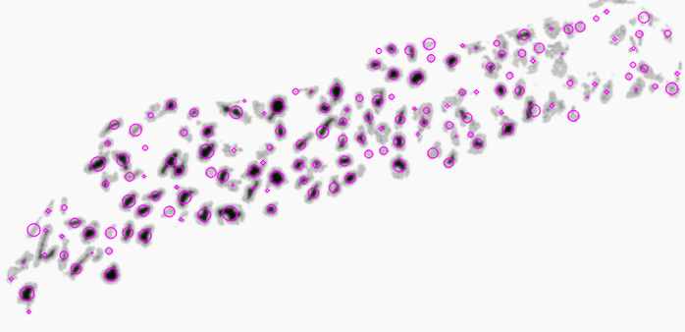
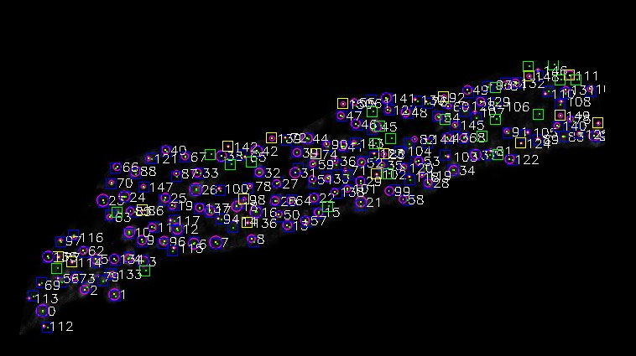
Explore the parameters, check how this affects TPs and FPs
Blue is the correctly identified cell (TP)
Green is the hand-labeled cell the computer missed
(FN)
Yellow is region incorrectly identified as cell (FP)

Slide 25
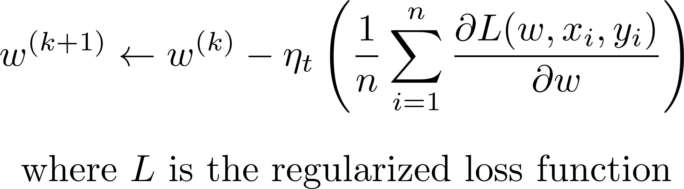
Batch gradient descent for ML
Process all examples together in each step
Entire training set examined at each step
Very slow when n is very large

Slide 26
Training Set
Training on multiple files simultaneously is good because it lowers risk of over-training
Generally, the more data, the better.
However, the more you have to label by hand, the less useful the machine learning is
Currently unclear if training can generalize to new training sets.

Slide 27
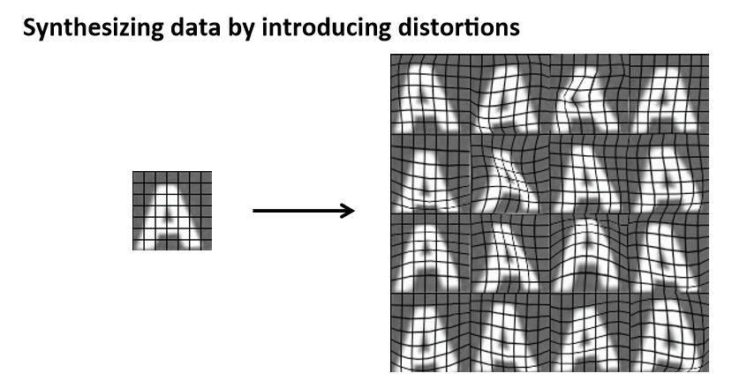
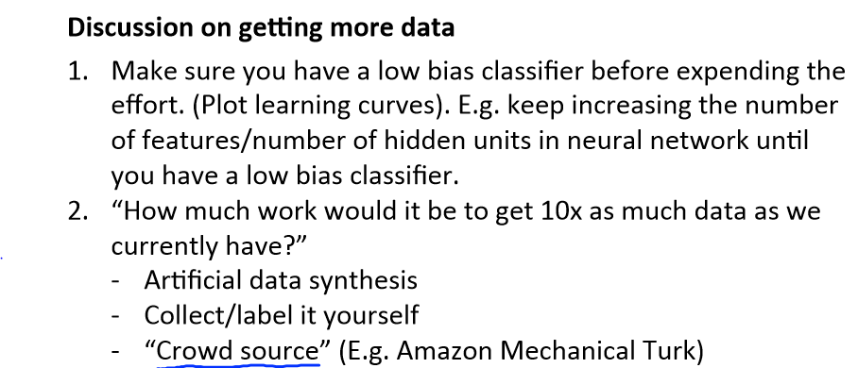
Future Directions
One way to get more training sets is to distort data/synthesis new data

Slide 28
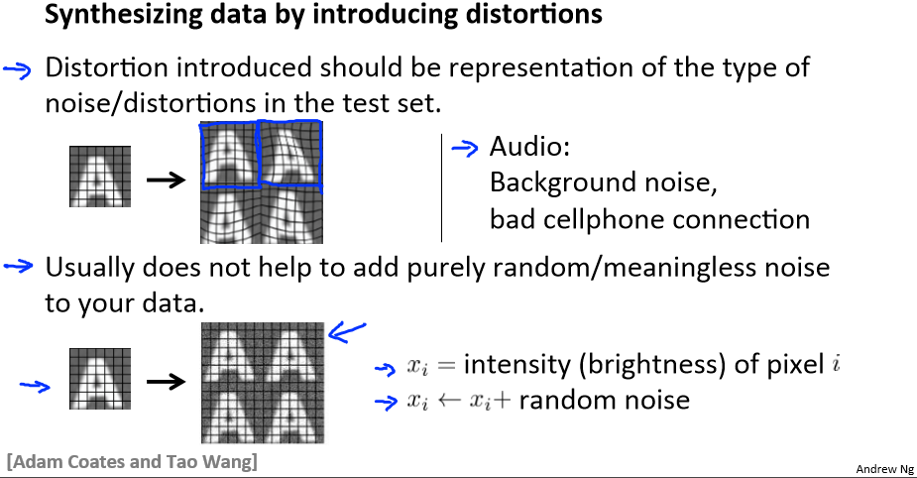

Slide 29
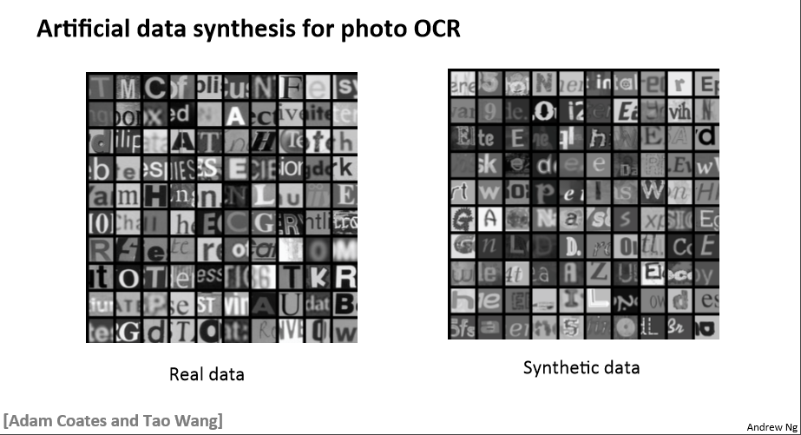

Slide 30
Free Resource to learn more about Machine Learning
https://www.coursera.org/learn/machine-learning

Slide 31
Supervised Machine Learning to Identify Cells (Using Python)
Ben Kuebrich

Slide 32
What is Python?
While MATLAB is more commonly used in science, but python is free, and because it is more flexible and powerful it is preferred by most programmers
Python is an easy-to-use programming language, with a large community, and many packages/libraries: pre-written commands for things like graphics, mathematics, gui, including sci-py
The scipy library allows you to perform most of the commonly used MATLAB commands in Python.

Slide 33
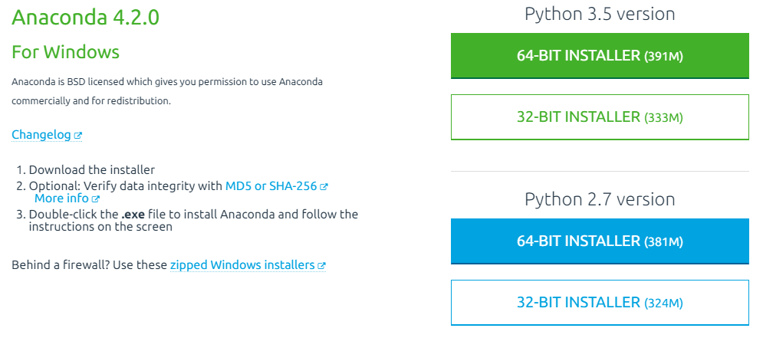
Installing Python (Anaconda Distribution)
Installation information can be found in:
\\LANDISK-HDD1\disk\ben\Ben-Cell-Labeler\Installation
Go to https://www.continuum.io/downloads

Slide 34
Installing OpenCV
The Anaconda distribution comes with many packages pre-installed, but we want to install OpenCV an opensource ‘computer vision’ package
OpenCV can do image manipulation and analysis.
Again installation information can be found in:
\\LANDISK-HDD1\disk\ben\Ben-Cell-Labeler\Installation

Slide 35
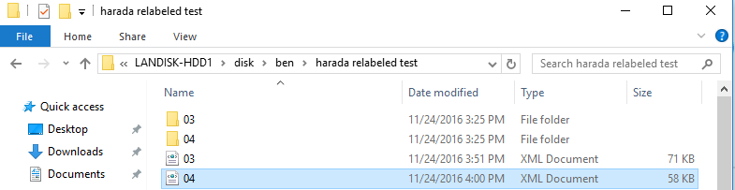
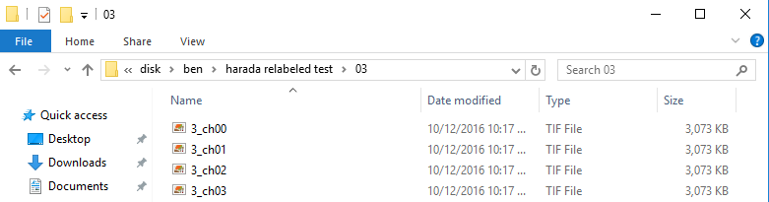
Setting up the Folder to Train / Analyze
Inside a new folder, Create a folder for each image
Inside the folder, put the files, they must contain the characters ‘ch00’, etc.
- ch00 should contain hoechst, or whatever stain you want to analyze, if there is another file in the folder it will treat that as the merge and use that as the images to show true positives, etc.
- in the main folder also put ‘.xmls’ in the same alphabetical order as the folders the correspond to

Slide 36
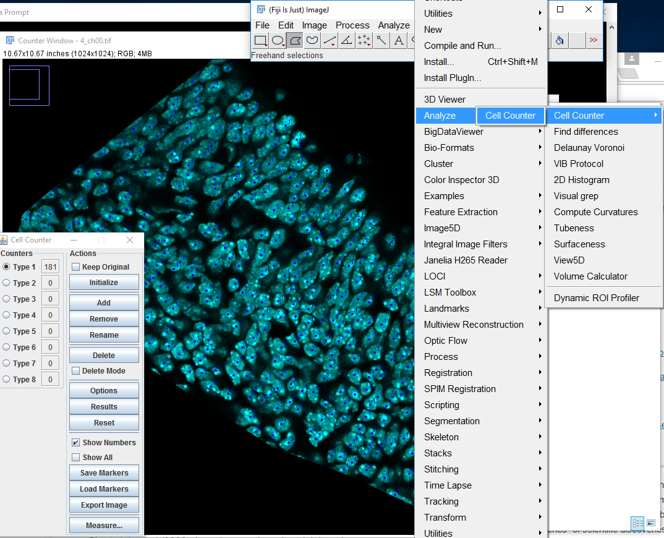
How to label files and generate the xml files
- Hand-Label cells for the training images in Fiji using plugins>analyze > cell counter
- Hand label all the cells trying to click in the middle of the image.
- Include partially-cut off cells on the edge of the images
- At the end click ‘save markers as .xml’
- in the main folder also put ‘.xmls’ in the same alphabetical order as the folders the correspond to

Slide 37
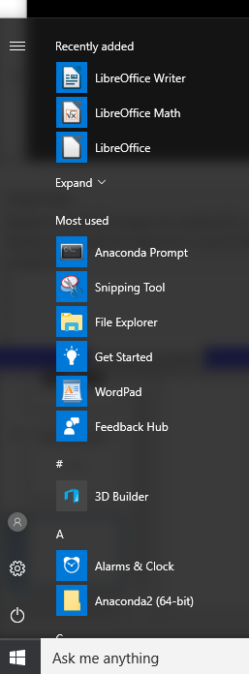
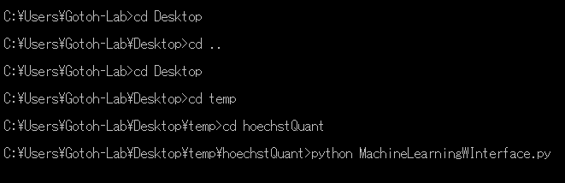
Running a Python Program
Folders can be navigated using commands:
>> cd _______
#enters a folder
>> cd ..
# goes back a folder
>> python _________.py
# opens a python program
----
Once the program is running pressing “ctrl + c” together can abort it, sometimes you will have to press multiple times to get the program to stop if it is in the middle of a calculation.
Selecting text pauses the program. Press enter to resume

Slide 38
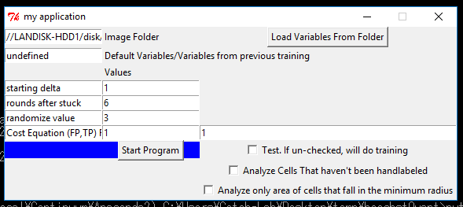
Running the Cell Labeler
Copy ‘ben-cell-labeler.py’ from \\LANDISK-HDD1\disk\ben\Ben-Cell-Labeler to a folder of your choice
Open the anaconda prompt and navigate to that folder as described on the previous slide
Type ‘python ben-cell-labeler.py’ to run the program
An interface will appear:

Slide 39
Using the GUI
Copy and paste in the folder you are using

Slide 40
Using the GUI
Copy and paste in the folder you are using
If you want the image to start using previously defined variables paste them here.
Variables trained on hoechst images with few overlapping cells: -565,47,40,45,33,49,35,20,33,36,34,-1,0,-1,0,32,28,28,31,-12,0,45,62,1,0,58,9,13,5,23,23,-26,12,49,111,47,32,43,0,27,18,18,29,-6,0,7,4,3,1,1,0,2,3,6,3,5,1,4,8,-4,3,18,12,16,12,10,13,22,21,21,10,21,16,16,18,78,60,24,0,16,40,15,20,7,15

Slide 41
Using the GUI
Starting delta, how big of steps to take.
Rounds after stuck, how many times it tries increasing the step size to get out of local minimums
Randomize, after it increases the step size if it can’t find a better set of variables.
If randomize = 0: it will stop
If randomize > 0: it will increase and decrease each variable by the amount in this box, and then start the whole process over again

Slide 42
Using the GUI
Cost equation: equation that the program tries to minimize:
(# of FPs it counts * fpWeight -
# of TPS it counts * tpWeight)
Higher fpWeight value will make the algorithm more sensitive
Higher tpWeight value makes the algorithm more accurate
Seems to be harder to find TPs than to eliminate FPs, so it may be best to first train with a higher TP weight: fpWeight=1
tpWeight=10
Then Afterwards train with fpWeight=1, tpWeight=1

Slide 43
Using the GUI
Test mode:
If unchecked, it will do training.
If checked, it will test labeled files to see the sensitivity and accuracy
Analyze mode:
If checked, will analyze unlabeled files
Analyze only area of cells that fall in minimum radius:
This averages the staining intensity only of the area shown inside the light pink circle

Slide 44
After analysis:
In the folder, files named as cellvalues0.txt, cellvalues1.txt, etc. contain staining information in comma-separated-value format that can be opened in excel.
These values are also labeled with unique cellID numbers, which can be referenced to images saved as LabeledImages0.tif, LabeledImages1.tif.
The order of these files corresponds to the alphabetical order of the folders you originally set up.

Slide 45
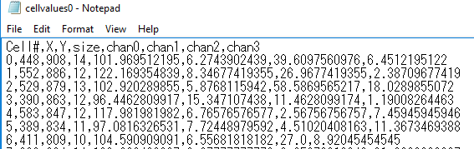
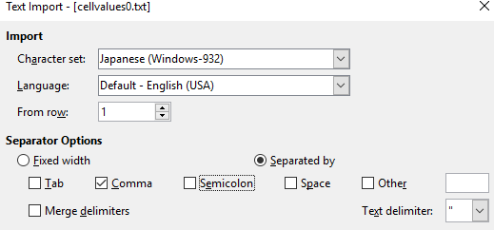
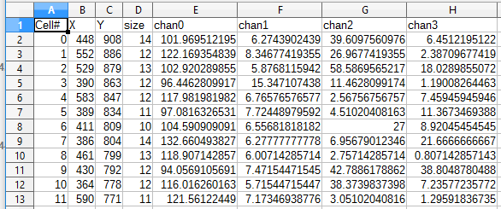
Cell Values

Slide 46
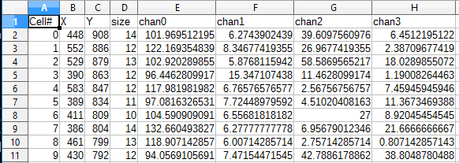
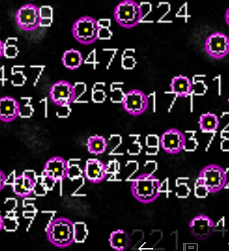

Slide 47
Using Python to Edit/Understand the Program
Ben Kuebrich

Slide 48
Download and install sublime text as a text-editor
https://www.sublimetext.com/

Slide 49
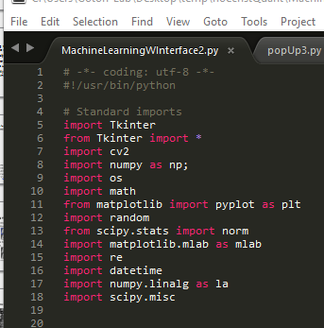
Editing Understanding the Program
‘#’ - denotes a comment, program does not read this just place for notes
‘Import’ and ‘from’ are used to load packages, useful sets of pre-written commands for things like graphics, mathematics, gui

Slide 50
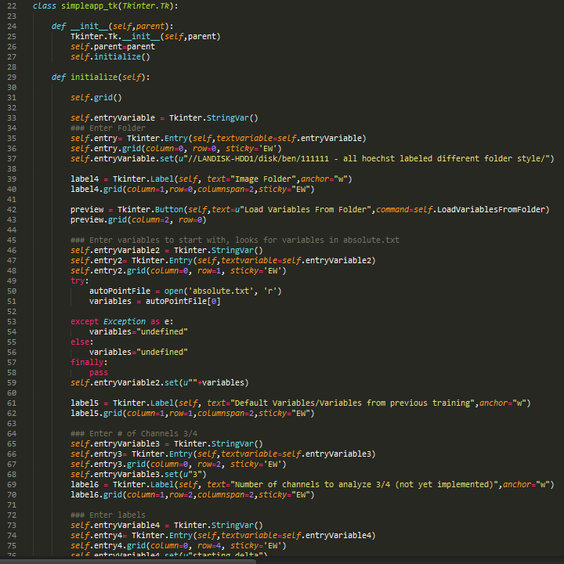
Set up GUI
Generates buttons and their actions

Slide 51
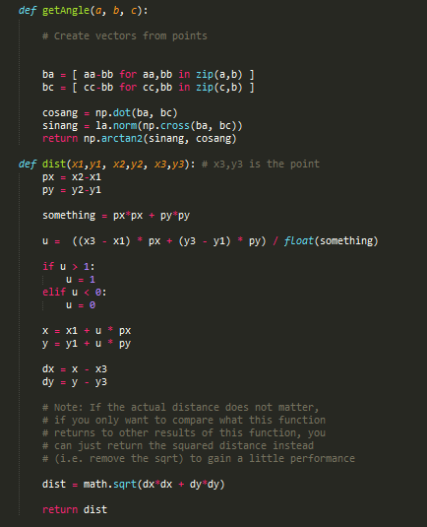
Some Calculations Used Later
- def starts a function
- If a piece of code is used in many places, you can write it as a function you define in the beginning and then call on it later.

Slide 52
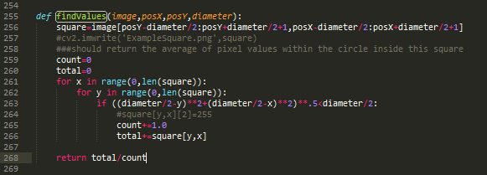
Find the average value of a stain within an area
This is used to make the calculations later on

Slide 53
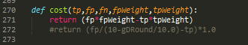
Calculates the cost equation
Calculations the cost equation, given the user-supplied weights
This is how the program decides if a change caused an improvement.

Slide 54
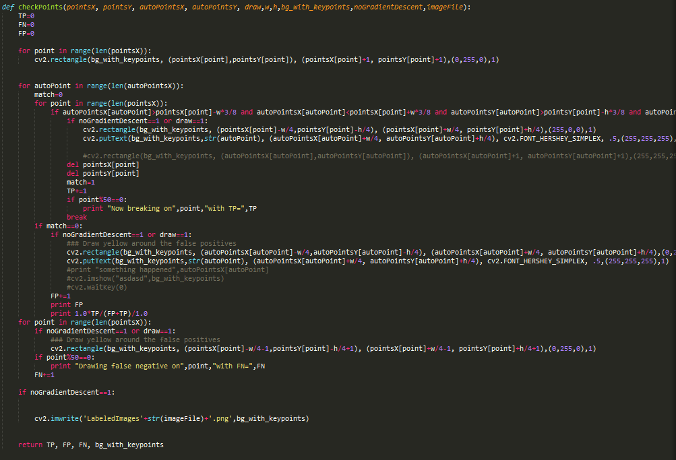
Check what points are TPs, FPs, FNs

Slide 55
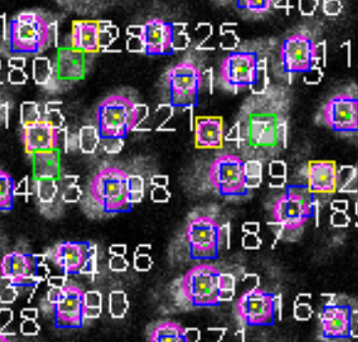
Check what points are TPs, FPs, FNs
Program looks through all hand labeled points,draws a box around them, and looks for a computer-generated point within that box.
If it finds one, that computer-generated point is labeled as a TP, and removed from the list so it won’t be double counted.
If it doesn’t find one, that cell is labeled as FN
At the end, computer-generated points that haven’t been marked as TPs get labeled as FPs

Slide 56
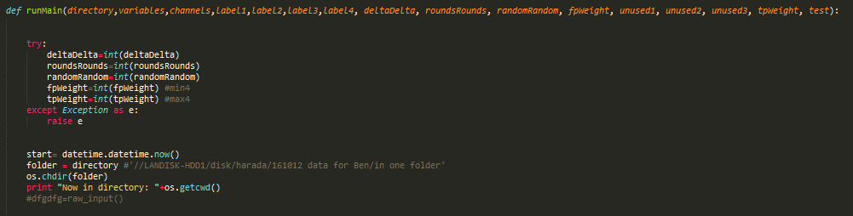
Begin main program
This starts the program and loads in the user-designated parameters
Also logs the time at this point

Slide 57
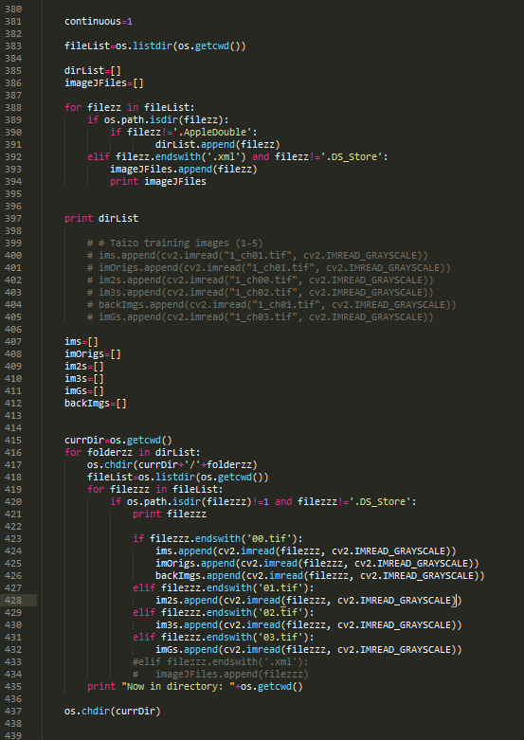
Load the image files and .xmls into lists
Goes through subfolders and loads the image files and xmls into lists
In your main folder, make sure there aren’t extra folders or extra xml files
Label folders and xmls with the same labels, so alphabetically they are in the same order

Slide 58
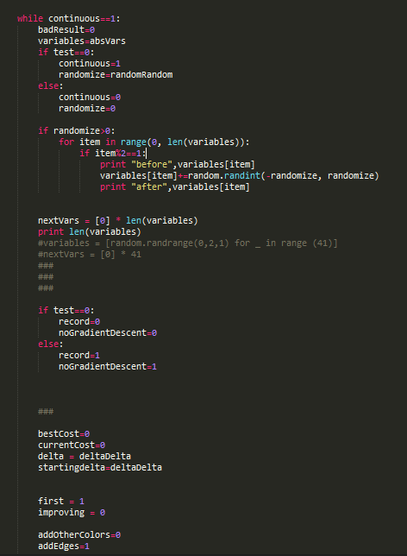
Outer While Loop
While at top initializes a loop
After the gradient descent gets stuck, this will randomly modify the variables, using the user-defined randomize variable, and then begin searching for a better solution
The absolute best solution found will be stored in ‘absolute.txt’ but only when one of these loops ends
If a better set of variables has been found within the current iteration of the loop, it will be stored in ‘bestvars.txt’

Slide 59
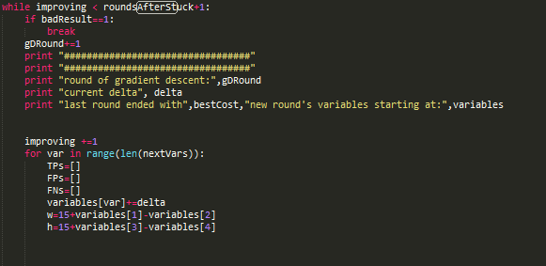
Gradient descent Loop
This while initiates one loop through the gradient descent

Slide 60
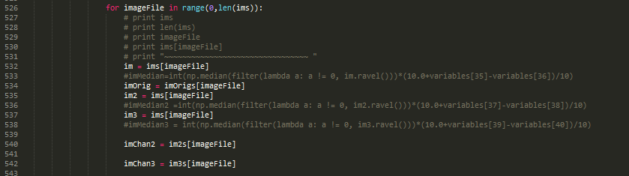
Loop through all images
This For loop begins the loop of looking through all of the images, and applying the current set of filters through them

Slide 61
Free Resource to learn more about Python programming
https://www.edx.org/course/introduction-computer-science-mitx-6-00-1x-9
Starts out assuming you have no knowledge in programming
Gets pretty advanced by the end, more than what you need to know to understand this program

Slide 62

Always check images, this is an example of an error from earlier version
Ran Overnight
6 100px100xp images w/
3 delta
3
3
FP – TP * 10
On the same images
Sens. TP/(TP+FN) = .748
Acc. TP/(TP+FP) = .888
But it’s overfitting. Based on this example, I constrained the minimum area, to be a proportion of the size of the boxes it uses to check for matches

Slide 63


Trained on the 6x 100p images, and tested on larger images
Sensitivity 0.279963403477
Accuracy of Positives 0.698630136986
Two are very dark
Added local Contrast
Sensitivity 0.472095150961
Accuracy of Positives 0.646616541353
Redid whatershed on their
own images: On larger versions of same images:
Sensitivity .73 other ver .625 Sens.: .649 other ver.:.65
Accuracy .78 .878 Acc. : .685 accuracy: .638
Trained newer version on “big images” Test on other “big images” from same set
Sens. .792 Sens. .609
Accuracy .869 Acc. .787
Made some updates because the algorithm was missing a very lightly stained
Image on the test set. Retrained for a couple hours
-541,41,40,45,33,48,33,21,29,33,30,-4,0,1,0,26,26,30,31,-12,0,43,60,-1,0,63,9,6,1,18,21,-27,12,46,107,45,28,40,0,28,16,15,27,-3,0,10,4,5,1,0,0,4,3,8,3,4,1,0,8,-9,3,12,12,16,12,10,13,20,21,22,10,11,12,12,12,66,60,19,0,21,40,12,20,11,9
Sens. 84.7 Test set: sens. .749 Tested on Harada’s images: sens. .90
Acc 79.1 Acc. .724 acc. .54
Retraining on 2 of 4 of Harada’s images ovenight for high sensitivity – TP 10, FP1
Sens 95 Other two images: 92.7
Acc 73.5 Acc: 72.6 ← for the most part mistakes are reasonable, unlabeled cells from the edge, and dim cells, but there . are occasional double- counts →
Retraining on the same 2 imagse with TP 2 FP 1:
-565,47,40,45,33,49,35,20,33,36,34,-1,0,-1,0,32,28,28,31,-12,0,45,62,1,0,58,9,13,5,23,23,-26,12,49,111,47,32,43,0,27,18,18,29,-6,0,7,4,3,1,1,0,2,3,6,3,5,1,4,8,-4,3,18,12,16,12,10,13,22,21,21,10,21,16,16,18,78,60,24,0,16,40,15,20,7,15
Sens. .912, Other two images: sens. .88
Acc. .835 acc. 80.7
-366,22,20,15,14,34,12,15,12,12,13,-6,0,3,0,16,15,12,13,-8,0,21,40,-4,0,42,4,3,1,7,12,
-16,12,19,48,21,19,19,0,14,4,4,5,-18,0,14,0,6,0,-4,0,-2,0,2,0,9,1,3,6, 9,0,11,9,6,9,5,9,8,6,1,0,3,0,3,0,22,24,6,0,17,33,10,0,6,0

